Slide 1
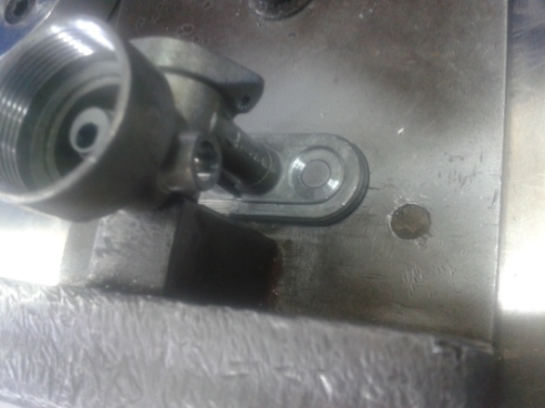
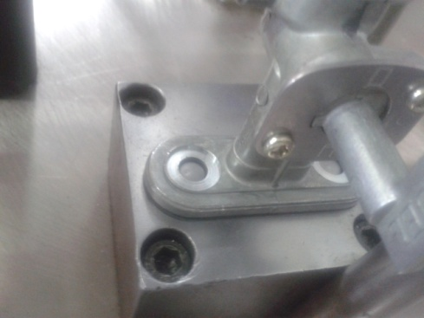
P15
TPM CIRCLE NO :- 3
ACTIVITY
KK
QM
PM
JH
SHE
OT
DM
E&T
KAIZEN IDEA SHEET
TPM CIRCLE NAME :P15 Team
LOSS NO. / STEP
DEPT :- Assembly
RESULT AREA
P
Q
DEF :- A
C
D
S
M
CELL :-A253
CELL NAME:-Fuel cock Assly
MACHINE / STAGE :- A253 Assembly Line
OPERATION :- Bowl fitment stage.
KAIZEN THEME : To eliminate may happen accident.
IDEA :- To make proper fixture design for job loading
COUNTERMEASURE:- Job locating pin height increase to avoid tilting of job.
BENCHMARK
1 No.
WIDELY/DEEPLY:-
TARGET
0 No.
KAIZEN START
12.06.2016
PROBLEM / PRESENT STATUS :- Unsafe condition at bowl fitment stage as job gets tilt due to job locating pin height less.
KAIZEN FINISH
17.06.2016
TEAM MEMBERS :-
Sheetal jadhav, Nitin Sutar
Bhavesh Sir
BENEFITS :-
Prevent minor accidents.
Eliminate unsafe condition.
KAIZEN SUSTENANCE
BEFORE
AFTER
WHAT TO DO: NA
HOW TO DO: NA
FREQUENCY :-NA
WHY - WHY ANALYSIS :-
Why1: Chances of may happen accident
Why 2: Unsafe condition at bowl fitment
Why 3: Job getting tilt while bowl fitment
Why 4: Job locating pin height less
RESULT :-
Under monitoring
COST INCURRED FOR MAKING KAIZEN
MATERIAL COST
IN RS
LABOUR COST
IN RS
TOTAL COST
IN RS
ROOT CAUSE:- Job locating pin height less.
------------
-------
---------
SCOPE & PLAN FOR HORIZONTAL DEPLOYMENT
REGISTRATION NO. & DATE: 17.06.16
SR.
NO.
CELL
TARGET
RESPONSIBILITY
STATUS
REGISTERED BY :- Bhavesh Pednekar
---
----
-------
------
------
MANAGER’S SIGN :- Janardan Sathe

